Slide 1
IBM University Engagement Project Submission
“Exploring the Power of Agentic AI with IBM Granite and LangFlow”

Slide 2

Project Tile – ShopSmart AI – Agentic Intelligent Shopping Assistant
Domain of Project – E-commerce
Student Name | Recent Passport Photo | Email ID | Mobile number [WhatsApp]
Tanushree Mohapatra |  | tanushree29108@gmail.com | 9380502914

Slide 3
Problem Statement -
Problem Statement No.11: Intelligent Shopping Agent
The Challenge
Shoppers today face an overload of product options, scattered reviews, and dynamic pricing across e-commerce platforms. Finding the right product that balances price, quality, and personal preferences is time-consuming and frustrating. Traditional recommendation systems often fail to capture real-time trends, personalized needs, or contextual factors like urgency, budget, or sustainability. The challenge is not just to recommend products but to act as a smart shopping companion that helps buyers make informed and confident decisions.

Slide 4
The Objective
Build an agentic AI shopping assistant that provides intelligent, personalized, and real-time support. The solution should:
1.Fuse Multisource Data: Aggregate product details, reviews, ratings, and price comparisons across multiple e-commerce sites into unified insights.
2.Enable Multimodal Search: Allow users to input voice queries, images (e.g., a photo of a product), or text descriptions to find best-matching products.
3.Create a Predictive & Agentic Layer: Suggest purchase timing (e.g., discounts, seasonal offers), recommend alternatives, and alert users about price drops or fake reviews.
4.Visualize Smart Shopping Pulse: Provide a dashboard summarizing comparisons, sustainability scores, trending products, and personalized shopping lists.

Slide 5
Proposed Solution -
ShopSmart AI is an Agentic AI-powered Intelligent Shopping Assistant that helps users make smarter purchasing decisions by combining IBM Granite Models, IBM Langflow, IBM Orchestrate, and RAG. It aggregates product information from multiple sources, compares prices, reviews, and specifications, detects fake reviews, predicts the best time to buy, and provides personalized product recommendations. Through specialized AI agents, the system also supports multimodal search (text, voice, and image), sustainability scoring, and an interactive analytics dashboard, enabling users to make informed, confident, and cost-effective shopping decisions.
Key Highlights
Multi-Agent AI architecture coordinated by IBM Orchestrate
AI-powered product comparison and personalized recommendations
RAG-based retrieval for trusted shopping insights
Multimodal search using text, image, and voice
Price prediction, fake review detection, and smart buying alerts
Interactive dashboard with trends, sustainability scores, and shopping analytics

Slide 6
Technology Used
IBM watsonx.ai Granite Models
IBM BOB
IBM Orchestrate (agent coordination)
ChromaDB (RAG knowledge base)
Python, Flask, Bootstrap 5
SQLite & Chart.js

Slide 7

Role of Agentic AI in the solution
Autonomous Multi-Agent Collaboration: Specialized AI agents independently handle product search, comparison, review analysis, price prediction, recommendations, sustainability scoring, and multimodal search.
Intelligent Orchestration: IBM Orchestrate dynamically routes user requests to the appropriate agent(s) and coordinates their responses.
Context-Aware Decision Making: Combines user preferences, real-time product data, reviews, and RAG-based knowledge to deliver personalized shopping recommendations.
Proactive Shopping Assistance: Predicts price drops, detects fake reviews, recommends better alternatives, and alerts users about the best time to buy.
Personalized Shopping Experience: Continuously learns user preferences to provide tailored product suggestions, shopping lists, and smarter purchasing decisions.

Slide 8
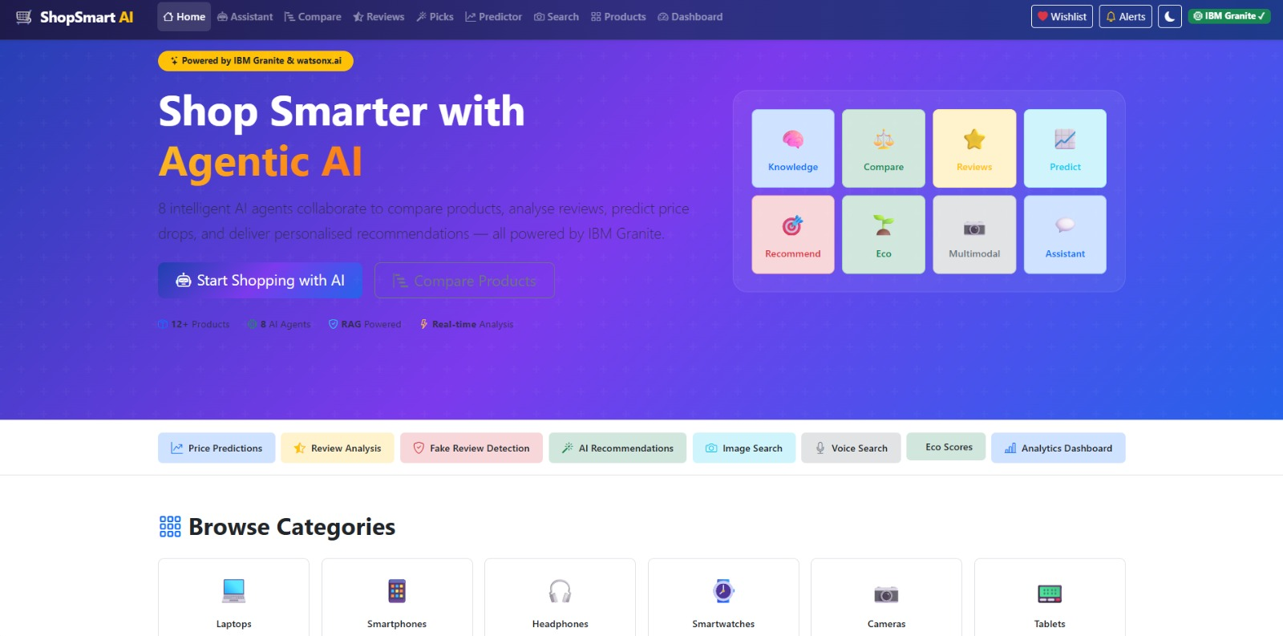
Screenshots

Slide 9
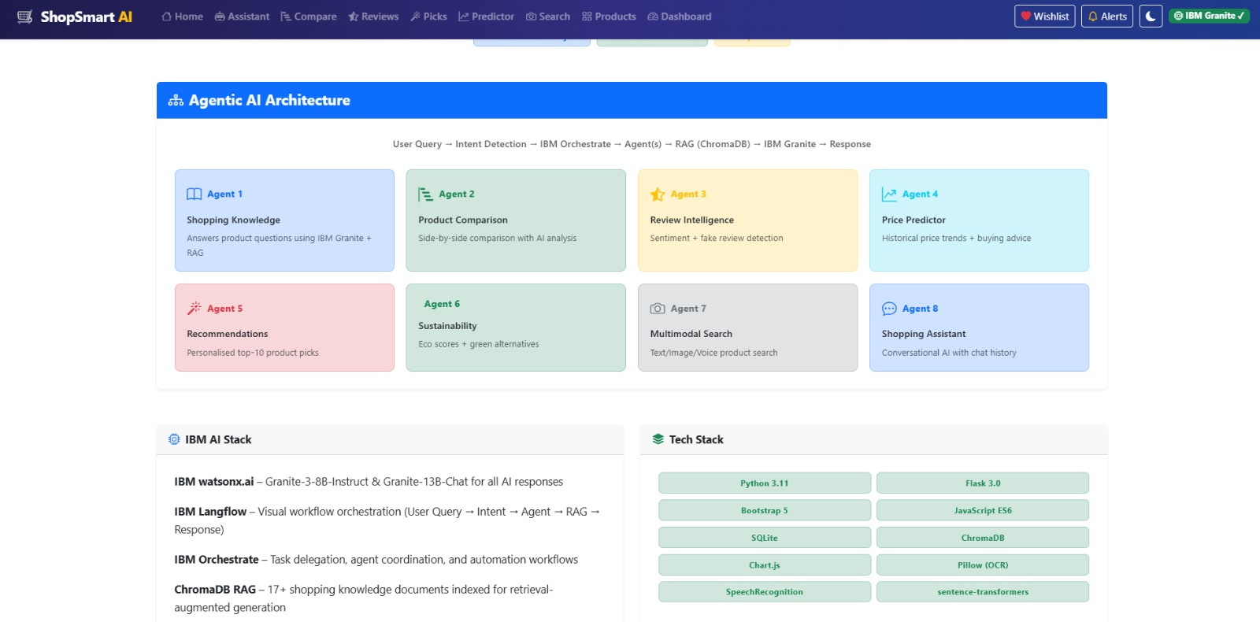
Screenshots

Slide 10
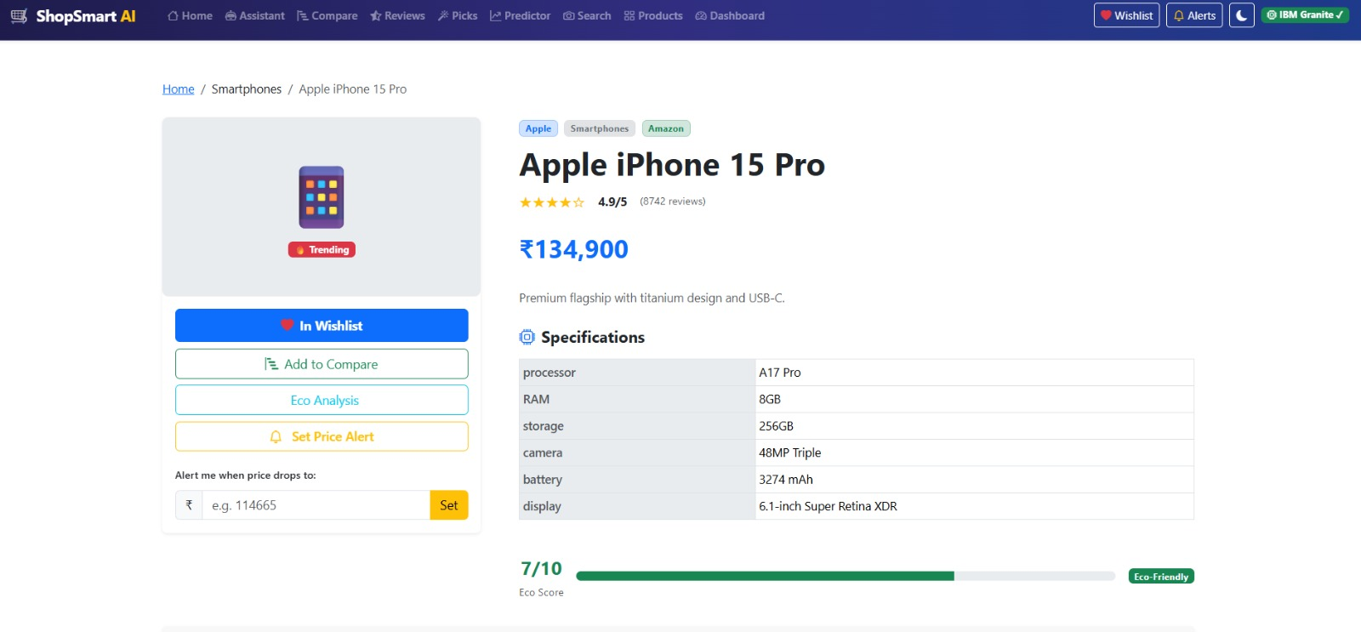
Screenshots

Slide 11
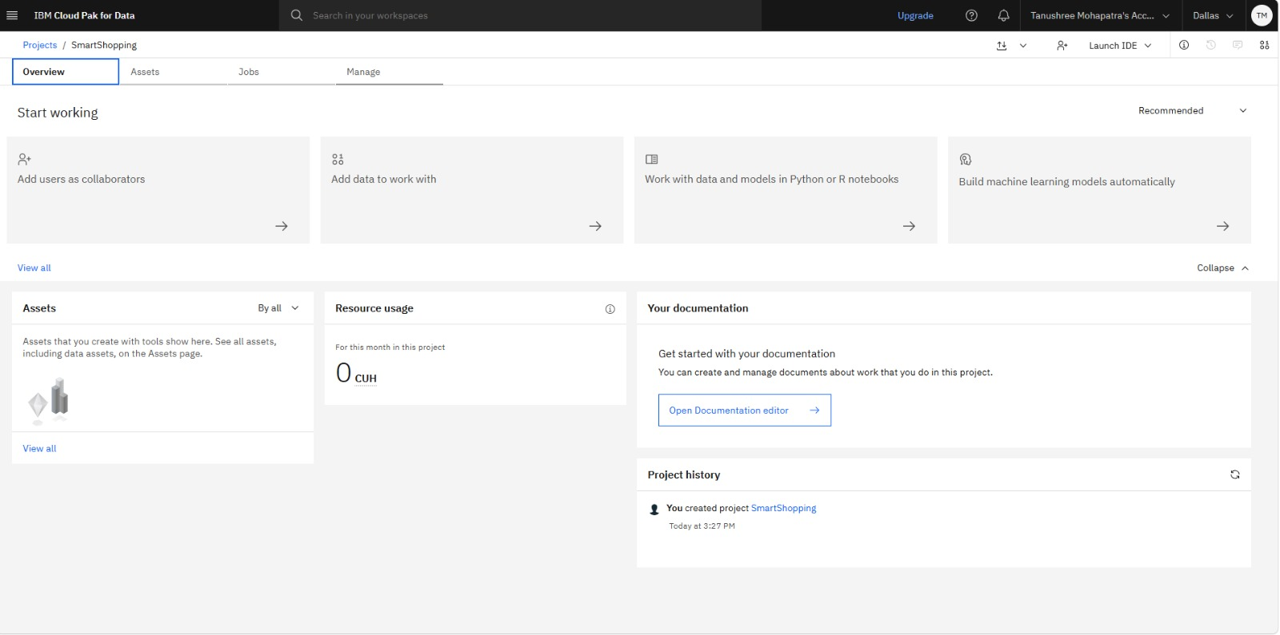
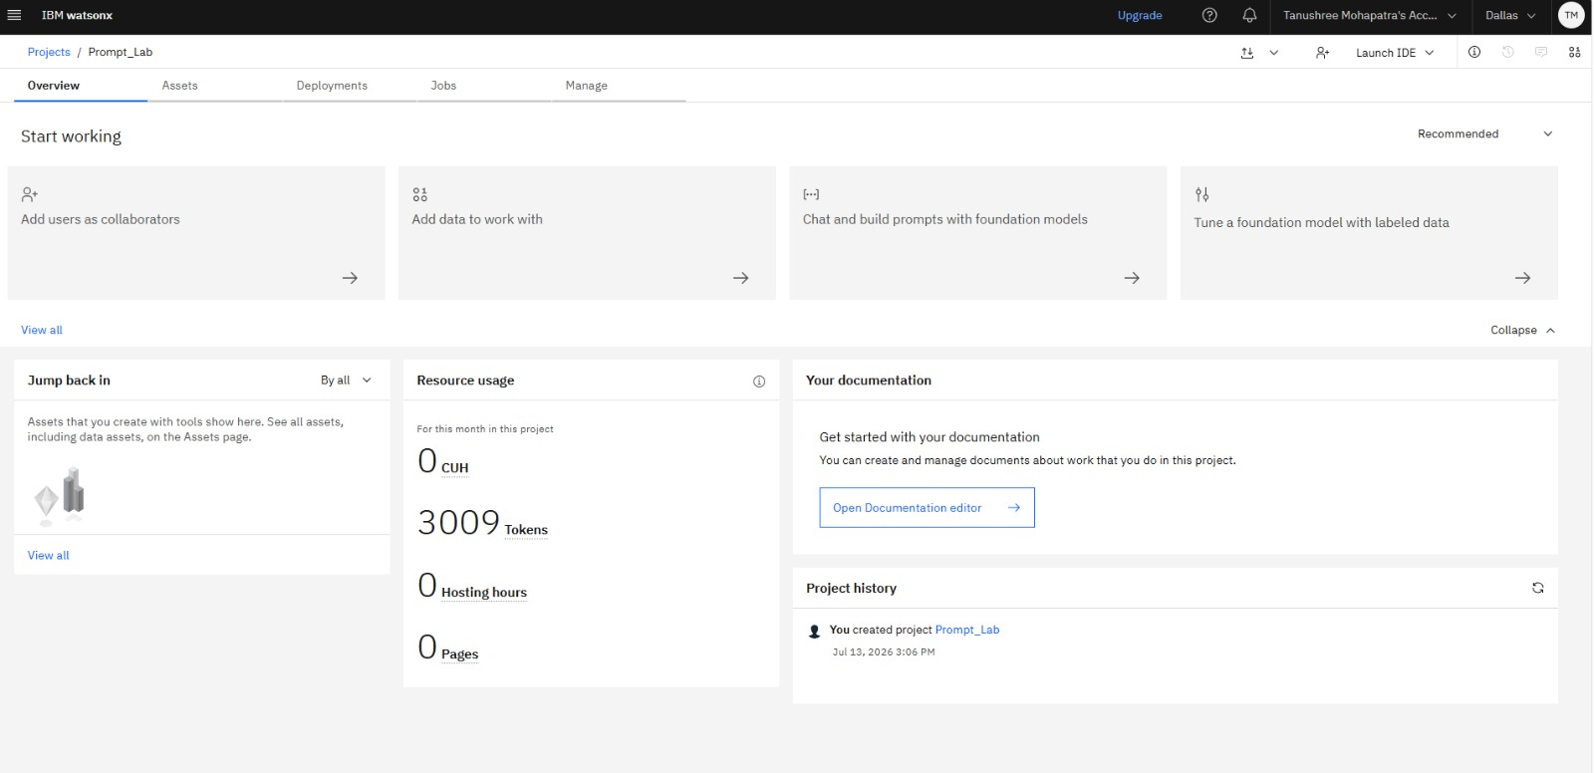
Token Usage
3009 tokens are used
Before Prompt
After the Prompt

Slide 12
Novelty and Uniqueness
True Agentic AI Architecture: Uses multiple specialized AI agents (Product Comparison, Review Analysis, Price Prediction, Recommendation, Sustainability, and Multimodal Search) instead of a single recommendation engine.
Intelligent Multi-Agent Collaboration: IBM Orchestrate enables agents to work together, delivering comprehensive and context-aware shopping insights.
AI + RAG Powered Decisions: Combines IBM Granite Models with Retrieval-Augmented Generation (RAG) to provide reliable, explainable, and personalized recommendations.
Predictive Shopping Intelligence: Forecasts price drops, identifies seasonal buying opportunities, and detects potentially fake reviews before purchase.
Multimodal Product Discovery: Supports text, voice, and image-based product searches for a seamless shopping experience.
Smart & Sustainable Shopping: Provides sustainability scores, eco-friendly alternatives, and an interactive dashboard with personalized shopping trends and analytics.

Slide 13
Git Hub Link
· Please create public github repository (Enable Add README button while creating repository) with format –
Please test and Paste the working Github URL –https://github.com/Tanushree-Mohapatra/Shop-smart-AI
Make sure you have Uploaded following three files into your github repository 1) app.json file , 2) yourproblemstatement.pdf file 3) your projectpresntation.pptx file 4)any other files
·
·
·

Slide 14
Future Scope
Real-Time E-commerce Integration: Connect with platforms like Amazon, Flipkart, and other retailers for live prices, availability, and offers.
Smart Price Drop Alerts: Notify users about discounts, flash sales, coupon availability, and the best time to purchase.
Advanced Multimodal AI: Enhance shopping with voice commands, image recognition, barcode scanning, and AR-based product visualization.
Personalized AI Learning: Continuously learn user preferences, shopping habits, and budgets to provide more accurate recommendations.
Sustainability & Carbon Tracking: Expand eco-scoring with carbon footprint analysis and greener product alternatives.
Enterprise Deployment: Deploy on IBM Cloud with secure authentication, scalable microservices, and multilingual support for global users.
·

Slide 15
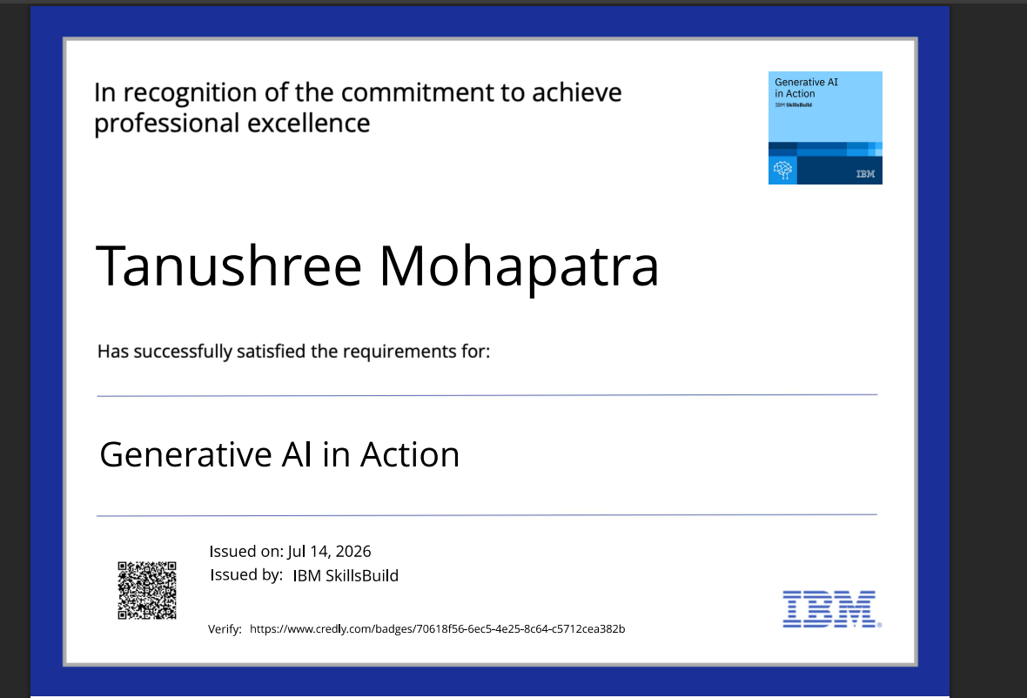
Certificates Earned:

Slide 16
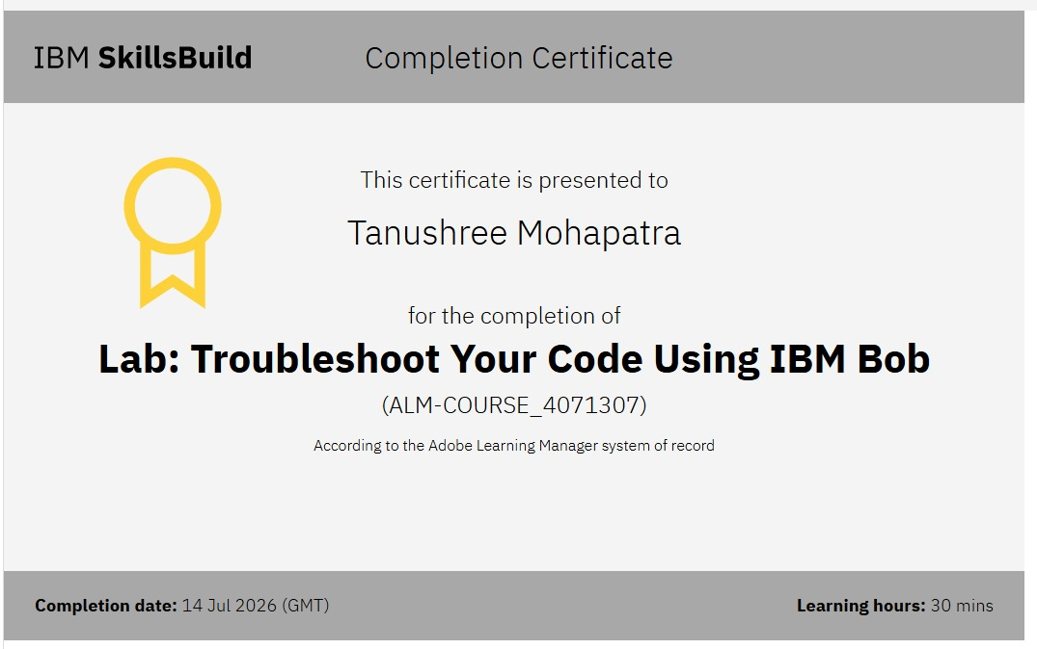
Certificates Earned:​

Slide 17


